Slide 1

EMBT-ESE 4009 Fall Detection and Monitoring for Oldsters Real Time operation
VEERPAL KAUR(770823)
GROUP-4

Slide 2
Content
Introduction.
An Overview of the Project.
Engineering Drawing
Block Diagram
Flow Chart
Components.
Code.
Output.
References.

Slide 3
In this presentation, we will discuss about an important part of this Project,which is the Real Time Operations. We will interface components and take values from different components at real time and will discuss the code and process.
Introduction

Slide 4
Fall Detection and Monitoring for Oldsters
Fall has become a big challenge to public health, especially among the elderly as their physical fitness deteriorates, a timely and effective monitoring is needed to reduce the negative effects of falls. We will discuss about a wearable device-based fall detection method.
Our Project will solve this problem, where all the components are connected to deliver the message for help. It consists ADXL345, Temperature sensor, pulse rate sensor, panic button, buzzer, ESP32, GPS and GSM to obtain live location, temperature and images for timely help.
A wearable gadget is put around a person's waist. Acceleration analysis allows the device to detect elderly people falling. The system will then determine the location of the elderly person and transmit a short fall warning alert to care-givers. As a result, the elderly who have fallen will receive prompt assistance, reducing the negative impact.

Slide 5
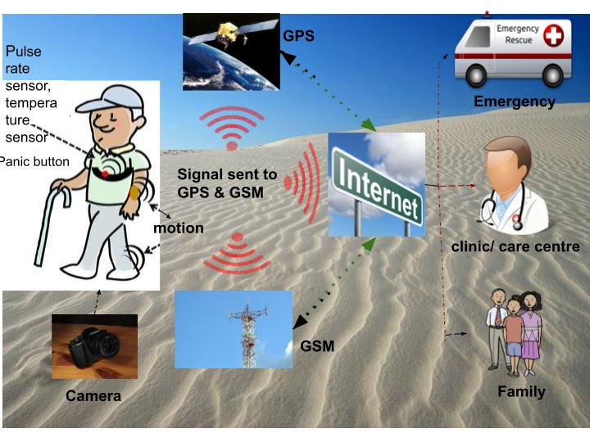
Engineering Drawing

Slide 6
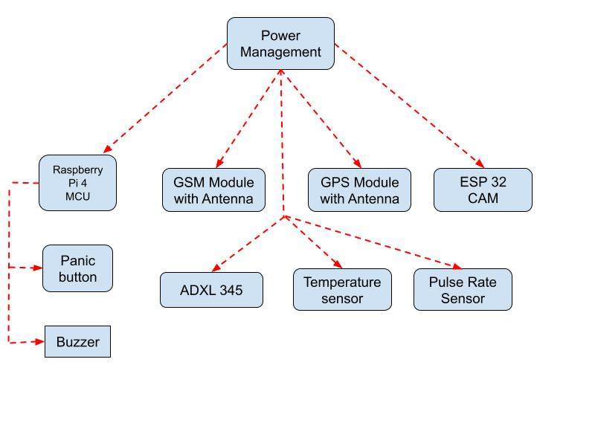
Block Diagram

Slide 7
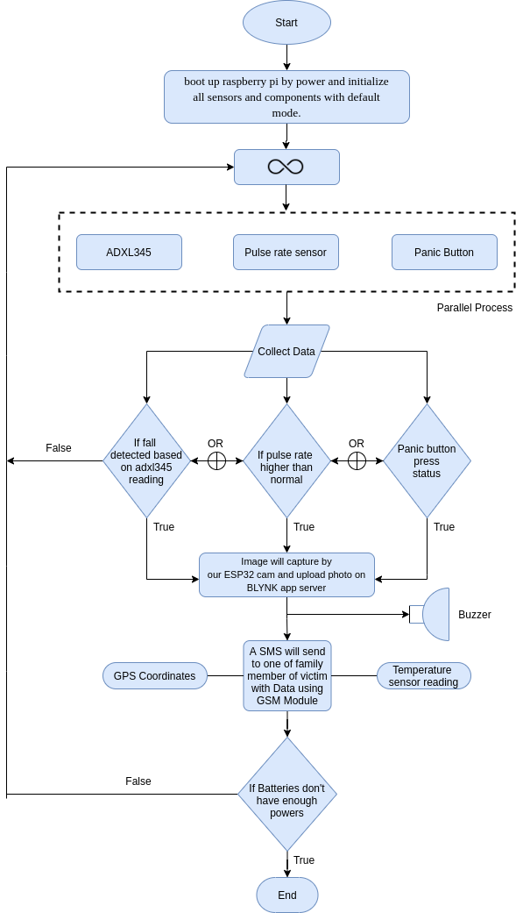
Flow Chart

Slide 8
Components
Raspberry Pi 4
Temperature sensor
Pulse rate sensor
Panic button
Buzzer
ESP32
GSM
GPS

Slide 9
Raspberry Pi 4 The Raspberry Pi 4 is powerful. It includes
USB-C power input.
2 video outputs that run 4K monitors, and RAM complements.
It is a single-board computer.
There is a Broadcom quad-core processor running.
Four USB Type-A ports.
Two micro-HDMI video outputs.
A gigabit Ethernet jack, and radios for 802.11ac Wi-Fi and Bluetooth 5.0.
All of these applications make use of the Pi 4's 40-pin General Purpose Input/Output (GPIO) connector.

Slide 10
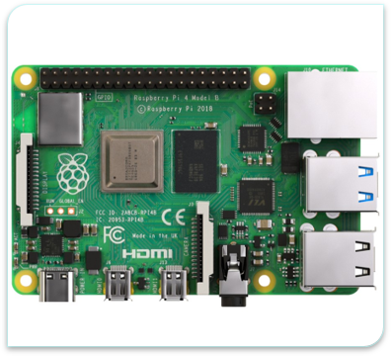
Datasheet:Raspberry Pi 4 Detailed Datasheet

Slide 11
Features
It comes with significantly enhanced CPU, GPU and I/O performance.​
The Raspberry Pi 4 comes with option of 2, 4, or 8 GB of RAM.​
Quad core 64-bit ARM-Cortex A72 running at 1.5GHz ​
H.265 (HEVC) hardware decode (up to 4Kp60)​
H.264 hardware decode (up to 1080p60) ​
Video Core VI 3D Graphics • Supports dual HDMI display output up to 4Kp60​

Slide 12
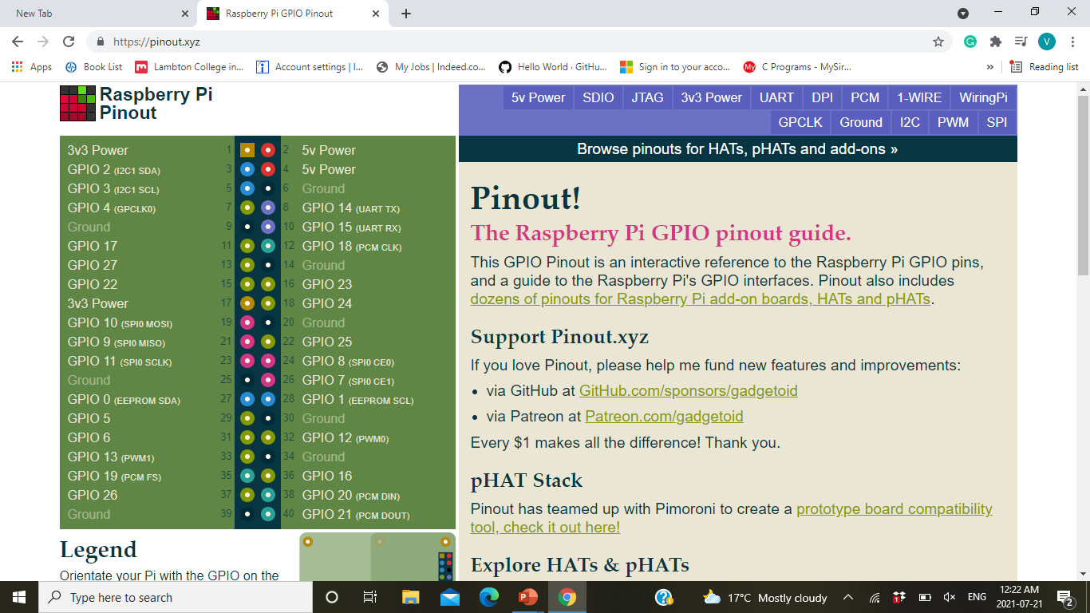
Pin layout

Slide 13
Temperature sensor
DS18B20 (Digital thermometer)
The DS18B20 Digital Thermometer provides 9 to 12-bit (configurable) temperature readings which indicate the temperature of the device.
Information is sent to/from the DS18B20 over a 1-Wire interface, so that only one wire (and ground) needs to be connected from a central microprocessor to a DS18B20. Power for reading, writing, and performing temperature conversions can be derived from the data line itself with no need for an external power source.

Slide 14
Temperature sensor
As we are designing a system which can detect the fall indoor as well as outdoor, so it is good if the system able to bear weather and DS18B20 is a perfect choice as it is waterproof and have a long probe to use over a distance if we want.
The connections are as:
Connect the VCC(Red) pin of DS18B20 to 5v pin of RPI4.
Connect the GND(Black) pin of DS18B20 to GND pin of RPI4.
Data pin(Yellow) is data that goes to GPIO pin 24 on RPI4.
Add a 4.7k pull-up resistor between the Data and power pin for stable communication.

Slide 15
Features
Unique 1-Wire interface requires only one port pin for communication.
Multidrop capability simplifies distributed temperature sensing applications.
Requires no external components.
Can be powered from data line. Power supply range is 3.0V to 5.5V.
Measures temperatures from -55°C to +125°C..
Fahrenheit equivalent is -67°F to +257°F .
±0.5°C accuracy from -10°C to +85°C .

Slide 16
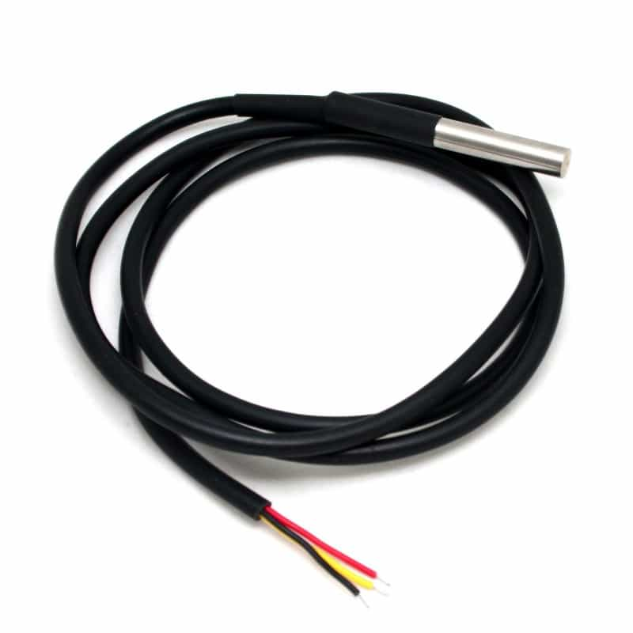
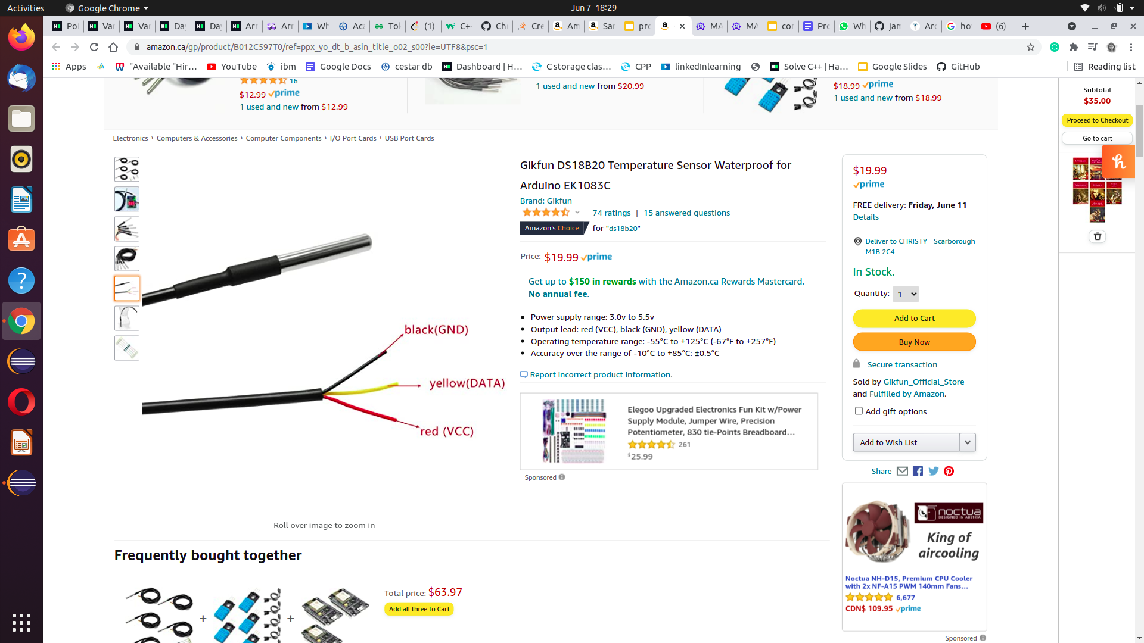
How it looks like:

Slide 17
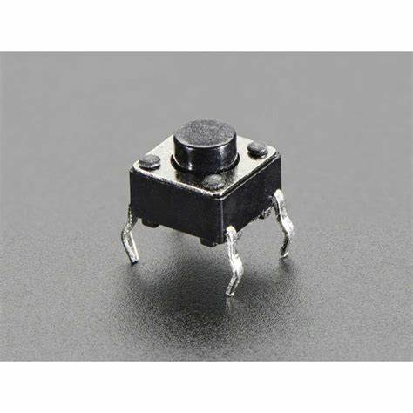
Panic Button

Slide 18
Panic Button
There can be any sudden situation of panic. It could be because of an intruder entering our house or bad health status.
Press Panic button if the person needs help.
Most panic buttons are specifically designed to resist accidental activation.
Panic buttons are used when it may be unsafe or uncomfortable to call for help in other ways.

Slide 19
Features and applications of panic button
Small and cheap
Reliable
Single/ double tap
Speed
Safety and Peace of Mind
Emergency Panic Buttons

Slide 20
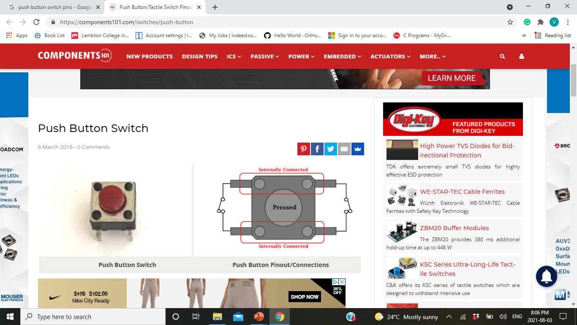
Connections
The Panic Button has 4 pins but as the pins are interconnected, we need 2 connections. One is the ground and another one is GPIO17.

Slide 21
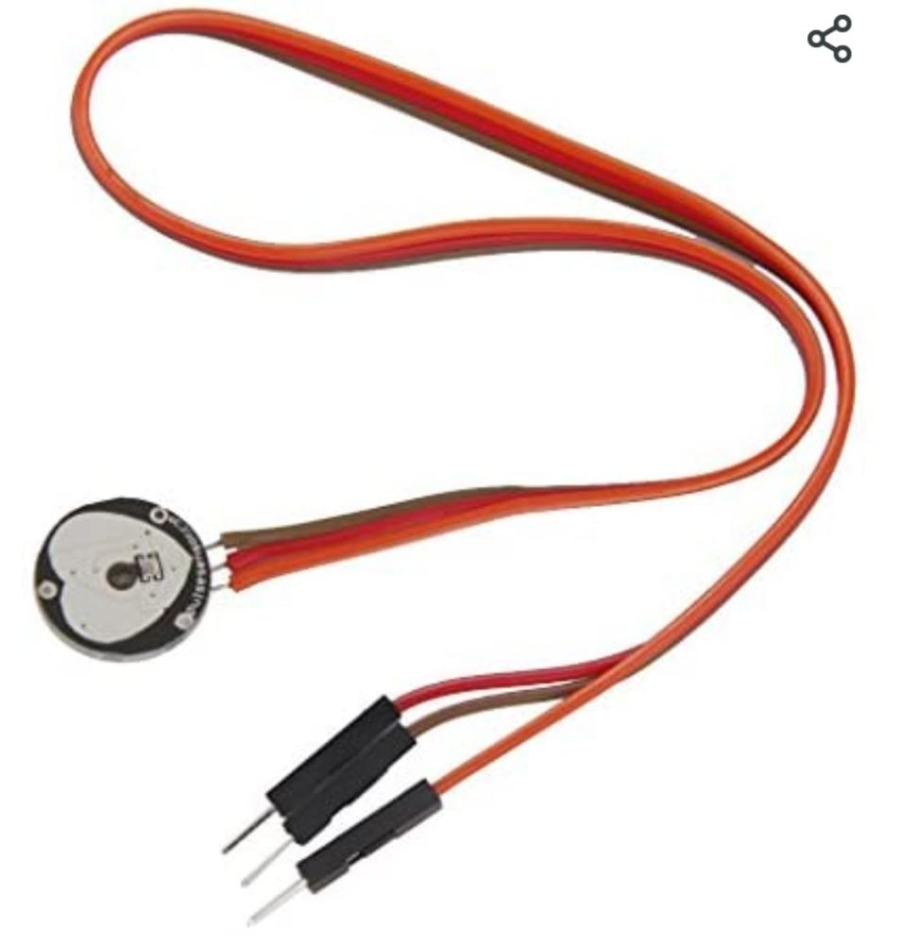
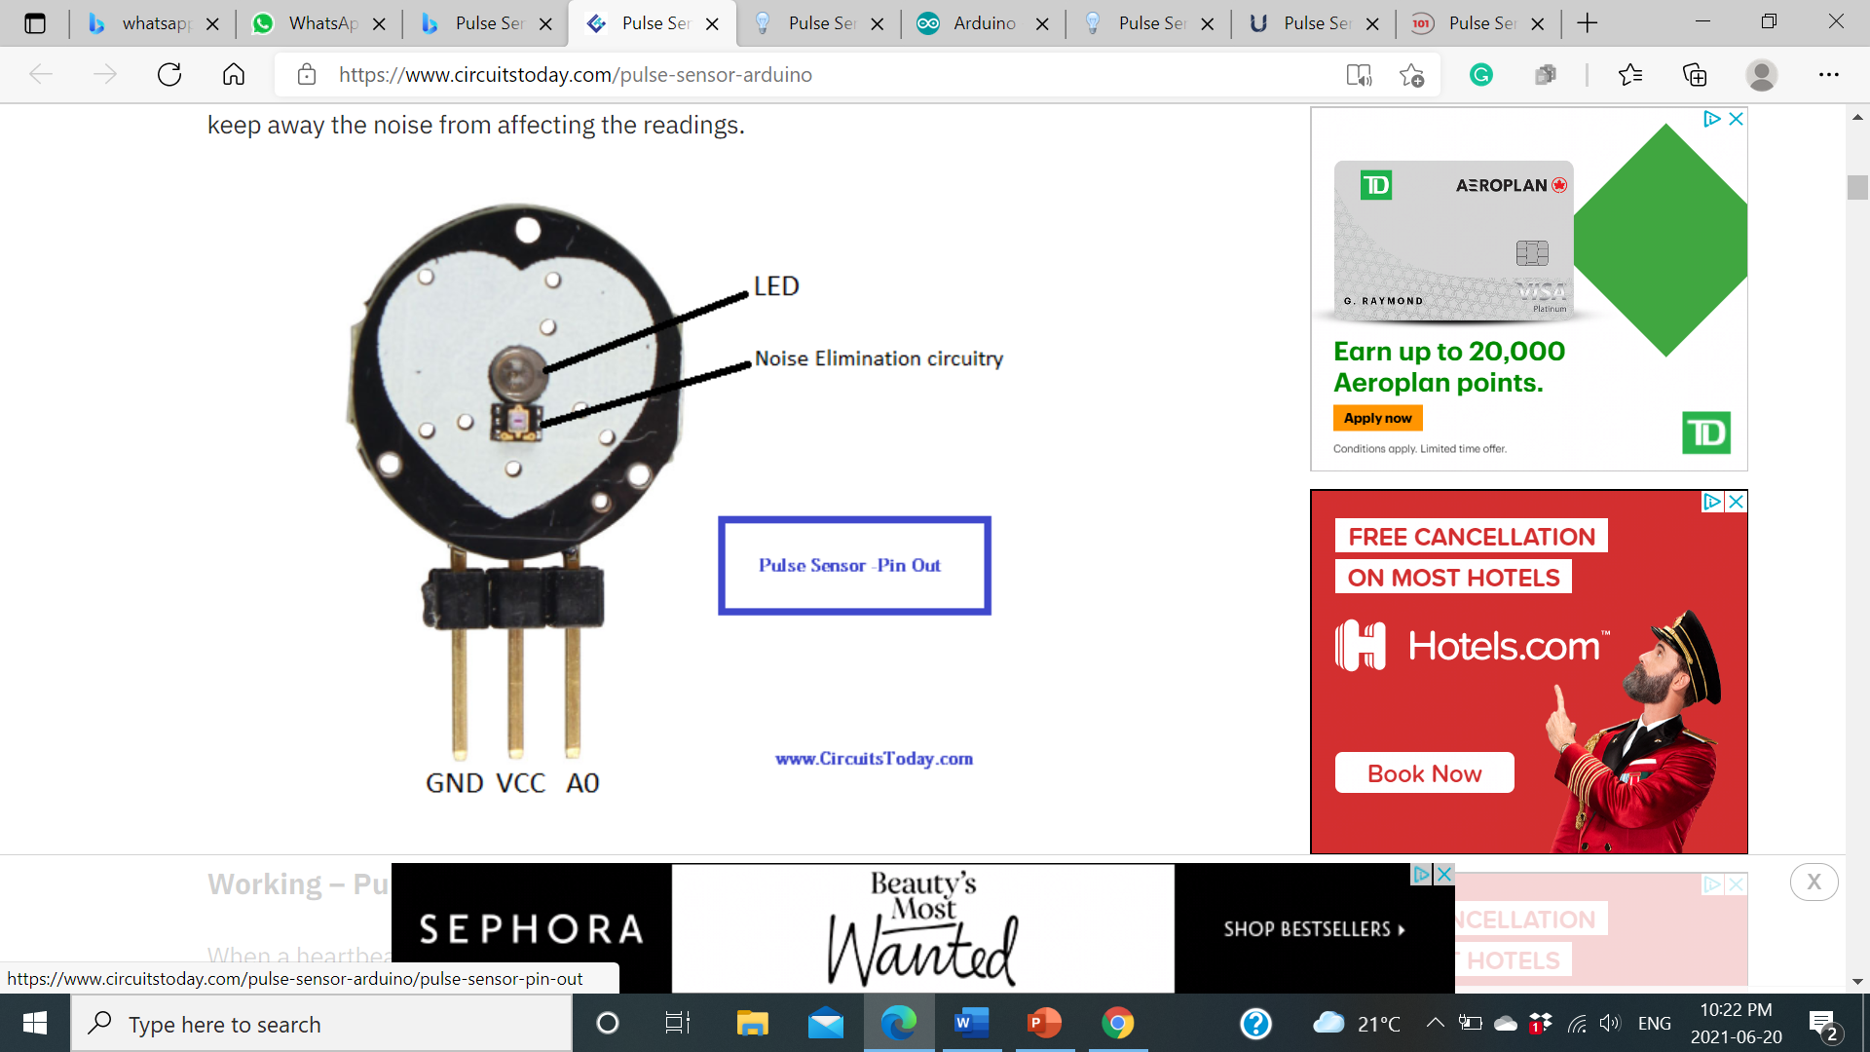
Pulse Rate Sensor

Slide 22
Pulse Rate Sensor
This sensor is heartbeat sensor or heart rate sensor
Pulse Sensor can be put on the finger or earlobe, through interconnected line can be connected to the Arduino, to test the heart rate.
So that heart rate can be easily calculated.

Slide 23
Features
This is a hear beat detecting and biometric pulse rate sensor
Its diameter is 0.625
Its thickness is 0.125
The operating voltage is ranges +5V otherwise +3.3V
This is a plug and play type sensor
The current utilization is 4mA
Includes the circuits like Amplification & Noise cancellation

Slide 24
Pin configuration of PRS
Pin-1 (GND): Yellow Color Wire – It is connected to the GND terminal of the system.
Pin-2 (VCC): Orange color Wire – It is connected to the supply voltage ( +5V otherwise +3.3V) of the system.
Pin-3 (Signal): Red Color Wire – It is connected to the pulsating o/p signal.

Slide 25
Application of PRS
This sensor is used for Sleep Tracking
This sensor is used for Anxiety monitoring
This sensor is used in remote patient monitoring or alarm system
This sensor is used in Health bands
This sensor is used in complex gaming consoles

Slide 26
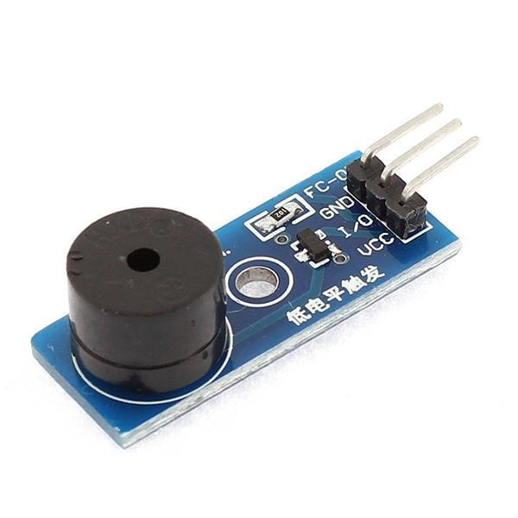
Buzzer

Slide 27
Buzzer
Buzzers are a simple and inexpensive means of providing communication between electronic products and the user.
The buzzer is normally associated with a switching circuit to turn ON or turn OFF the buzzer at required time and require interval.
Active Buzzer module produces a single-tone sound when trigger. To produce different tones, use the Passive Buzzer module.
The Active Buzzer module consists of a piezoelectric buzzer with a built-in oscillator. It generates a sound of approximately 2.5 kHz when activated.

Slide 28
Features of Buzzer
Operating Voltage:3.5V ~ 5.5V
Operating Current: 30mA@5VDC
Trigger Level: Active Low.
Resonance Frequency: 2500Hz±300Hz
Sound Output Level: 85dB @10cm
Dimensions (LxWxH): 32mm x 13mm x 11mm

Slide 29
Applications of buzzer
Alarming Circuits, where the user must be alarmed about something
Communication equipment's
Automobile electronics
Portable equipment's, due to its compact size

Slide 30
GPS Module
The Global Positioning System (GPS) is a worldwide radio-navigation system formed from an arrangement of 24 satellites and their ground stations. GPS uses these “man-made stars” as reference points to calculate positions accurate to a matter of meters. In fact, with advanced forms of GPS you can make measurements to better than a centimeter. In a sense it’s like giving every square meter on the planet a unique address.
GPS modules contain tiny processors and antennas that directly receive data sent by satellites through dedicated RF frequencies. From there, it'll receive timestamp from each visible satellites, along with other pieces of data.
The GPS receiver gets a signal from each GPS satellite. The satellites transmit the exact time the signals are sent. So given the travel time of the GPS signals from three satellites and their exact position in the sky, the GPS receiver can determine your position in three dimensions – east, north and altitude.
GPS does not need any kind of internet or wireless connection, but there are technologies like A-GPS that use the mobile network to shorten the time to first fix, or the initial positioning or increase the precision in situations when there is a low satellite visibility.

Slide 31
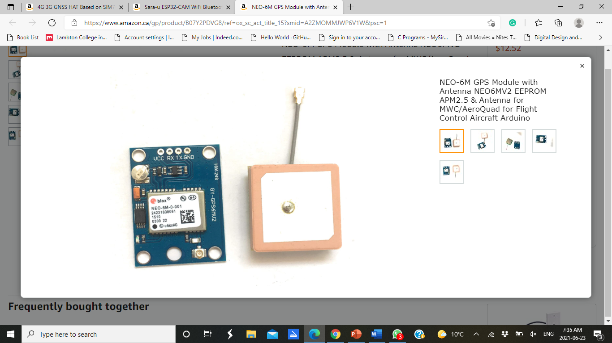

Slide 32

Where does GPS used ?
Location – Determining a basic position
Navigation – Getting from one location to another
Tracking – Monitoring the movement of people and things
Mapping – Creating maps of geographical locations.
Timing – Bringing precise timing to the world

Slide 33

What is the Function of GPS Module
In our Fall detection and monitoring system for oldsters, this system give us an update about any fall detected.
So if the fall is detected, the exact location of the oldster will be sent to the to care-taker.
This is why GPS is helping us in it to measure the accurate position.

Slide 34
GSM Module
GSM is a mobile communication modem; it stands for global system for mobile communication (GSM). It is a widely used mobile communication system in the world. GSM is an open and digital cellular technology used for transmitting mobile voice and data services operate at the 850MHz, 900MHz, 1800MHz, and 1900MHz frequency bands.
GSM technology was developed as a digital system using the time division multiple access (TDMA) technique for communication purposes. A GSM digitizes and reduces the data, then sends it down through a channel with two different streams of client data, each in its own particular time slot. The digital system can carry 64 kbps to 120 Mbps of data rates.

Slide 35
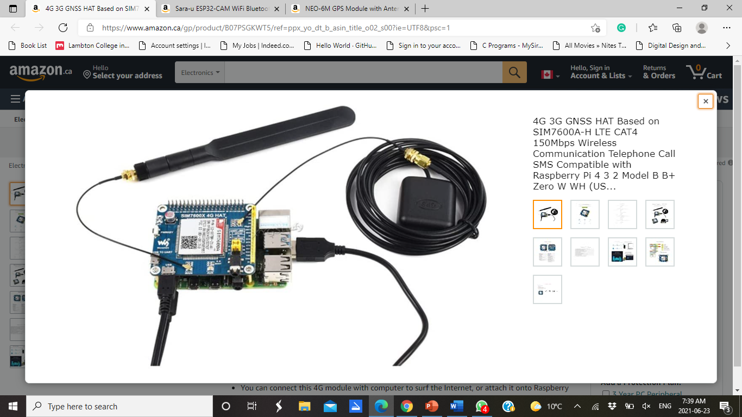

Slide 36

What is the Function of GSM Module
In our fall detection and monitoring system we need to send the notification of the detected fall to one of the family member of the old person.
For the alert purpose, we need this technology of GSM .
It helps us to send the message to the family member of the person at such crucial time.

Slide 37
ESP32
A feature-rich MCU with integrated Wi-Fi and Bluetooth connectivity for a wide-range of applications.
ESP32 is the ESP8266 successor. The ESP32 is loaded with lots of new features when compared with its predecessor. It combines Wi-Fi and Bluetooth wireless capabilities and dual-core.
ESP32 can perform as a complete standalone system or as a slave device to a host MCU, reducing communication stack overhead on the main application processor. ESP32 can interface with other systems to provide Wi-Fi and Bluetooth functionality through its SPI / SDIO or I2C / UART interfaces.
You can find the ESP32 as a full-featured development board.

Slide 38

What is the Function of ESP32 in our project
When there would be any fall detected by the system, it will use its camera to upload pictures on the cloud.
It will upload pictures on the BLYNK cloud and using BLYNK app the care-taker can see those images.

Slide 39
CODE
In this task, we have set the priority. Using a reference, we have developed the C++ program in which panic button was given the highest priority and the least was given to buzzer.
Consider a scenario, in which a person presses the button, system will assign the highest priority to panic button and send the message to the care giver with Pulse rate, Temperature, location and photo.

Slide 40
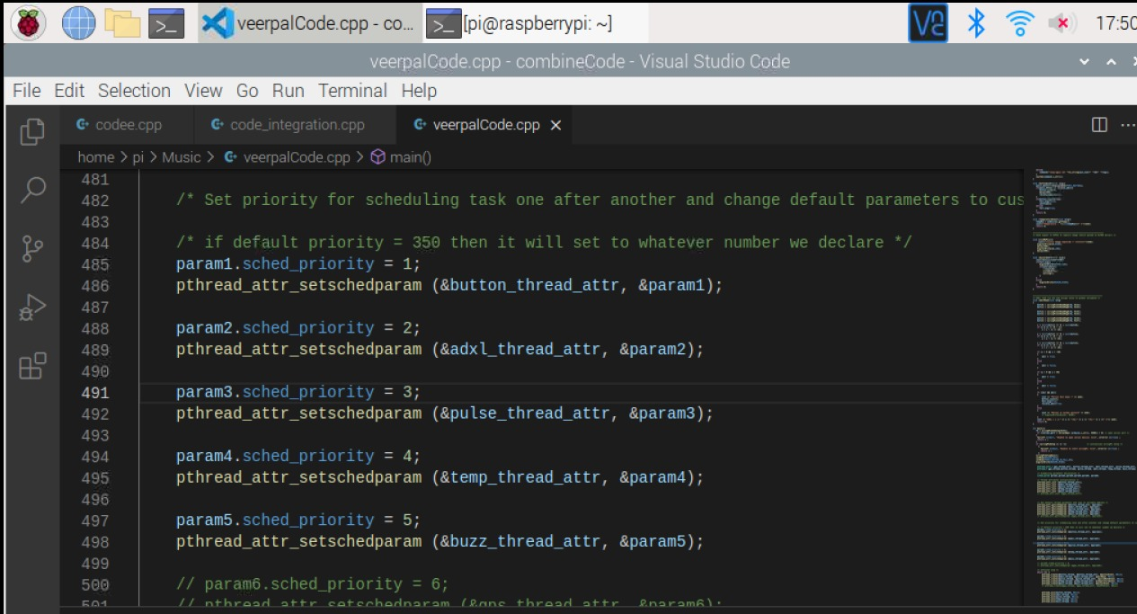

Slide 41
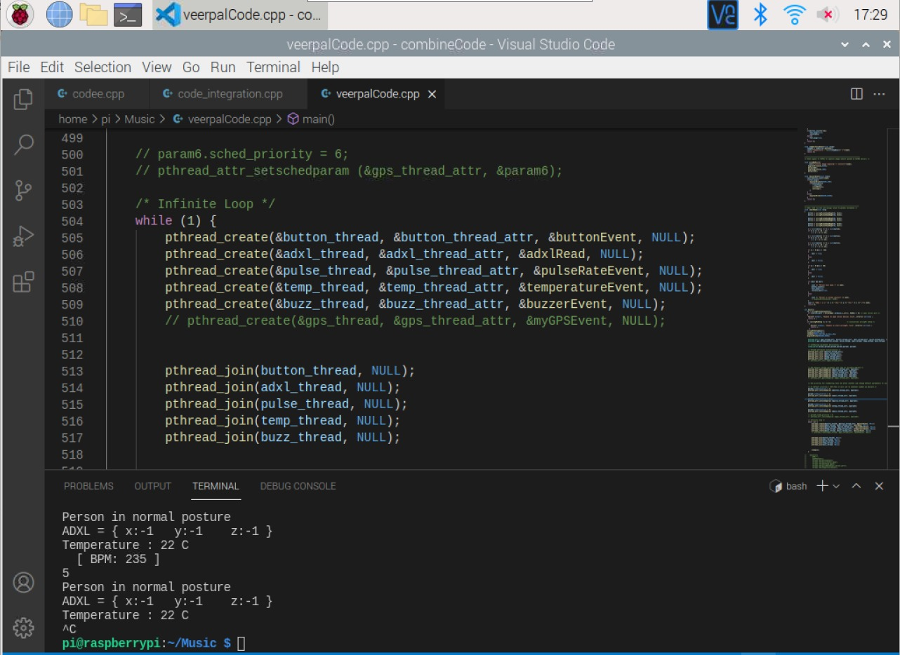
Output

Slide 42
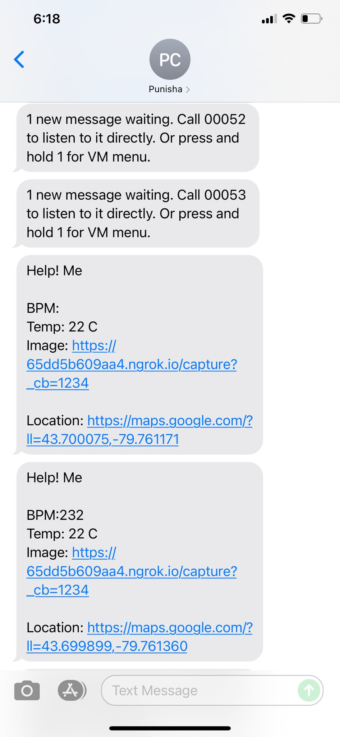

Slide 43
References
Documentation Home, O. (n.d.). Multithreaded Programming Guide. Oracle. https://docs.oracle.com/cd/E19455-01/806-5257/6je9h032j/index.html
Tutorialpoint. (n.d.). C++ Multithreading. Learn C++ Programming Language. https://www.tutorialspoint.com/cplusplus/cpp_multithreading.htm
Engi, L. M. (2021). Interfacing DS18B20 1-Wire Digital Temperature Sensor with Arduino. Last Minute Engineers. https://lastminuteengineers.com/ds18b20-arduino-tutorial/
Howard, P. (n.d.). Pinout. Raspberry Pi Pinout. https://pinout.xyz/
What is GPS, how GPS module is used for base station applications, how to choose GPS module ?,(2017, Oct 4)https://www.techplayon.com/gps-gps-module-used-base-station-applications-choose-gps-module/
GeeksforGeeks.(2018,Feb 8.),How GSM works ?
https://www.geeksforgeeks.org/how-gsm-works/

Slide 44
References
ESPRESSIF.(n.d.),ESP32 https://www.espressif.com/en/products/socs/esp32
Circuits Today.(n.d.), ESP32 Development Boards Review and Comparison https://www.circuitstoday.com/gsm-and-gprs-module-price-guide
Bill Earl .(n.d.), ADXL345 Digital Accelerometer. Overview | ADXL345 Digital Accelerometer | Adafruit Learning System
Dallas Semiconductor.(n.d.), Programmable Resolution 1-Wire Digital Thermometer (sparkfun.com)
Silva Consultants.(n.d.), Introduction to Panic Alarms (silvaconsultants.com)
Hands on Tech, Active Buzzer Module – Low Level Trigger – HandsOn Tech
Pulse rate sensor Pulse Sensor : Pin Diagra,. Working, Circuit Diagram & Its Applications (elprocus.com)
Pulse sensor (2021, Jan 28) Pulse Sensor-Definition, Working and Applications – Utmel

Slide 45
THANK YOU

